Slide 1
Map Module
Joy Division

Slide 2
Requirement Analysis
Wenzhi Li

Slide 3
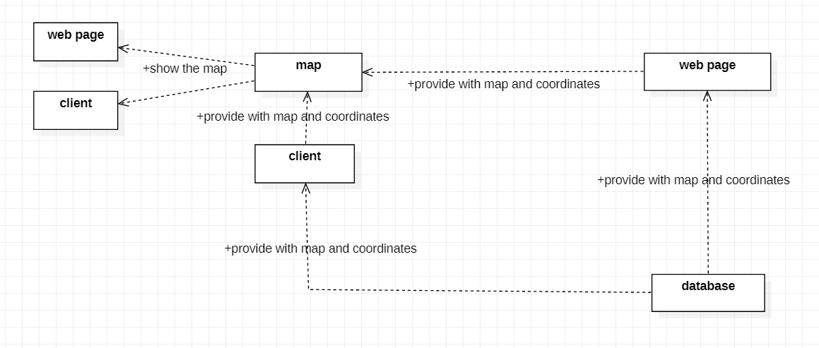
Internal Requirements
Notes:
The internal requirements is given above. In general, our module get position data from web page/client and integrate them with BaiduMap API to show on web page/client.

Slide 4
Aims of the Module
Get map picture and coordinates of points to be shown.
Add the picture as a layer onto the API, and mark out users position/track.
Provide integrated map to client/web page.

Slide 5
System Design
Yuming Feng

Slide 6
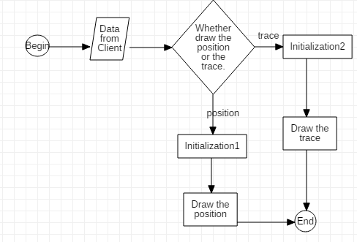
Workflow

Slide 7
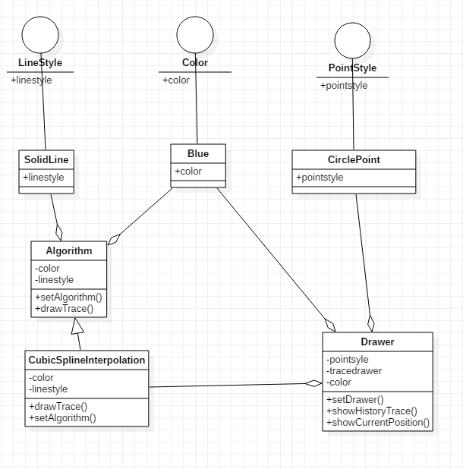

Slide 8
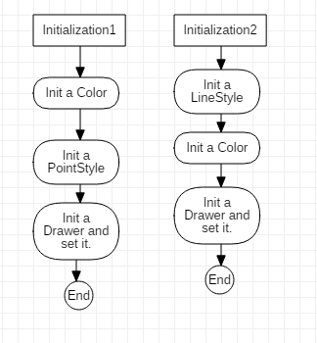

Slide 9
Access Method | Parameter name | Parameter type | Description | Exceptions | Map to services
showPosition | mapid、UserPosition、graphCenter | int、Point、Point | mapid is the id of the map(jpg/png picture) and the UserPosition is the GPS position(the id of the gps). graphCenter is the GPS coordinary of the map. | If the coordinates of the point exceed the range of the picture, an error PointOutOfBoundaryException is reported. | 1
showTrace | mapid,UserTracks, graphCenter | int、array of points、Point | pointlist is an array of GPS coordinaries to describe the trace of the user. | If the coordinates of the point exceed the range of the picture, an error PointOutOfBoundaryException is reported. If the list of points is empty, an error PointNotFoundException is reported. | 2

Slide 10
Coding
Haochen Liu and João

Slide 11
Implementation
Context：
1.tool introduction
2.Achievement (video show)

Slide 12

Tool Introduction——BaiduMap
Baidu Maps is a desktop and mobile web mapping service application and technology provided by Baidu
Offering satellite imagery, street maps, street view and indoor view
Android and iOS applications are available.
More than 150 countries are supported

Slide 13
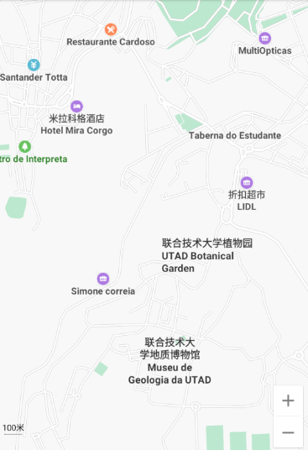
BaiduMap API
This API is similar to Google Maps (easier to work)
Have the maps of the bigger part of world (include Portugal)
Can be customized
Include SDK for Android
Various guides available

Slide 14
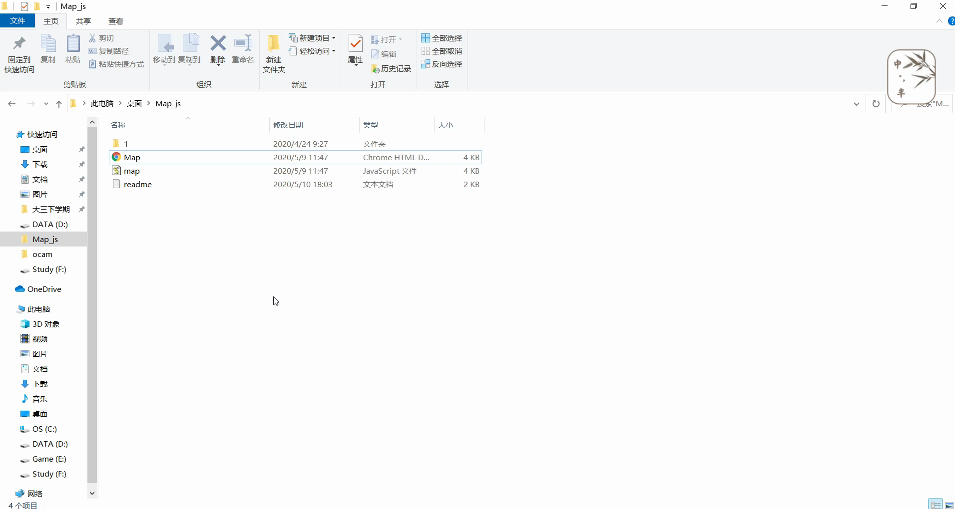
Show

Slide 15
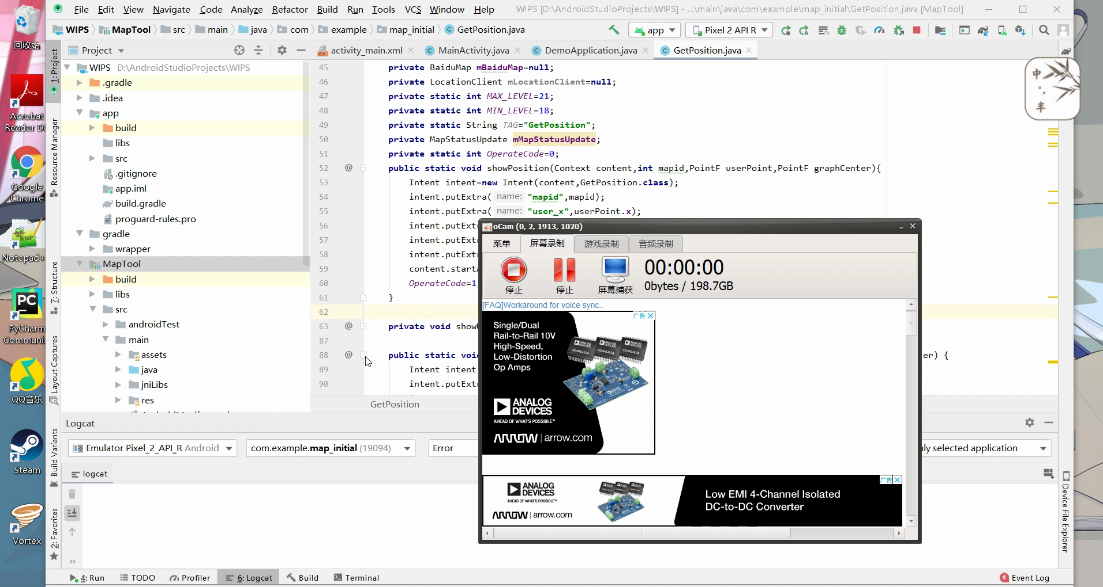
Show

Slide 16
Testing
Tianke Zhang and Inês

Slide 17
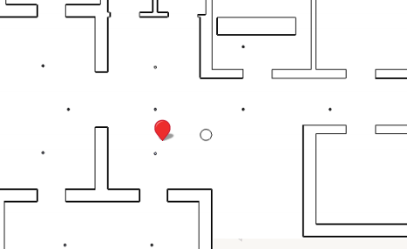
Test on JavaScript
① Point Location：opCode = 1, mapid = 1, center point fixed
Input：longitude&latitude of the point
Use Python program to complete the test for the legend range, and the punctuation is accurate
Problem: Other location information under the
original layer may interfere with mouse click.

Slide 18
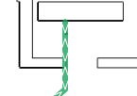
Test on JavaScript
② Trace Display：opCode = 2, mapid = 1, center point fixed
Input：a list of the location of points ( longitude&latitude)
Use Python program to complete the test for trace display, and the direction and location are accurate.
Problem: When the path goes back and forth between
two points, the displayed path is not clear enough and
the order will be confused

Slide 19
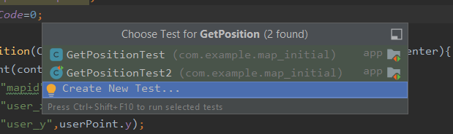
Test on Android
To create a correct test class, it is necessary to open the file that contain the functions in Android Studio and press Alt+Ctrl+T to generate a class test.
We can also select what functions we want to test.

Slide 20
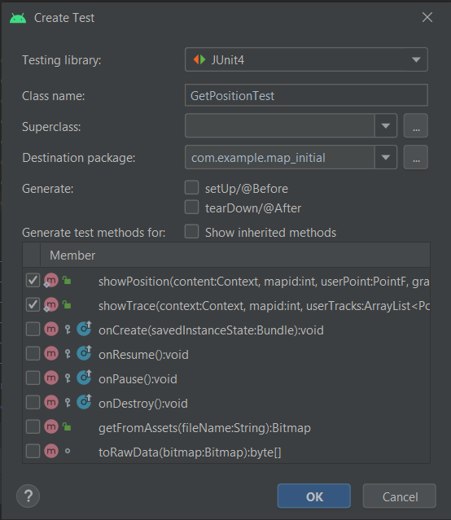
Select the targeted library
Choose name class
These options are to generate
Automatic Code
Select functions who wants to test
Confirm

Slide 21
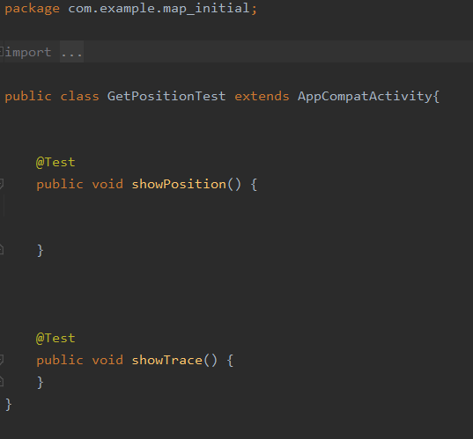
Generated Class

Slide 22
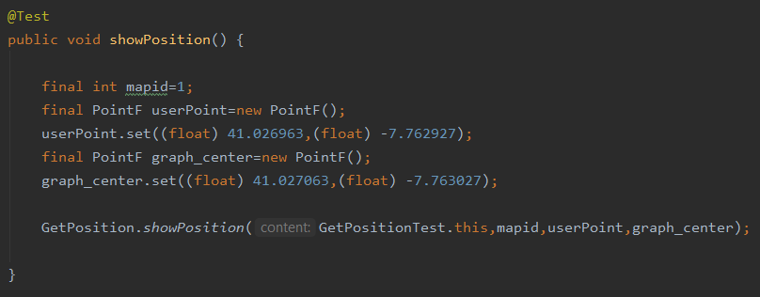
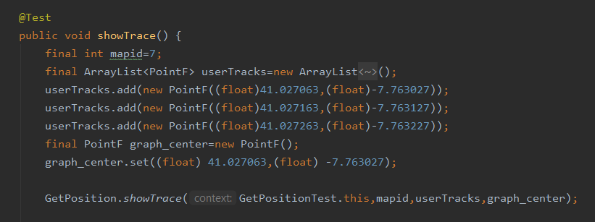
Test Settings
Notes:
We have tested the code several times wtih different parameters

Slide 23
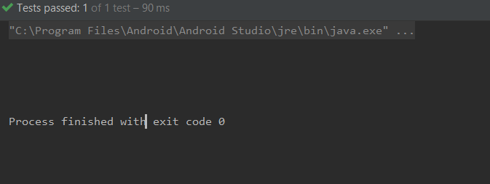
Result: No Error

Slide 24
Test Conclusion
Our code passed the first part of the test, but there are still some details to be adjusted.

Slide 25
Conclusions
Lihao Wang (Felix)

Slide 26
Plans
Review the documents (RA, SD, IS, etc.) corresponding to RA_2, SD_2.
Review the software description document before Code-2.
Make more comprehensive testing.
Prepare to solve problems that may appear during integration.

Slide 27
Visions for Future
Use more interesting icons to mark out the position.
Show some text above the icons.
Make tracks more colorful.
Notes:
There are many interesting icons online, and some may be more interesting than the icon we use at present.
Given that the GPS coordinate of reference points is provided, we could show the coordinate above the icons. However, since texts may cover the map, this adaptation needs more discussion.
The track consists of many lines. A more colorful track may be more user-friendly.

Slide 28
Thanks for Listening!

